Slide 1
Grocery
Dash
Take the stress out of grocery shopping

Slide 2
The inconvenience of grocery shopping
Here’s some complaints we’ve heard:
Complicated, ever-changing grocery store layouts that vary from store to store.
Too much time spent wandering looking for your specific items.
Does a Brita filter go under groceries? Outdoors? Electronics?
Nobody likes asking store employees for directions - a quick trip should involve minimal human interaction.
A 5 minute run turns to a 40 minute one bouncing from aisle to aisle
Instacart or Uber eats and other grocery shopping platforms are too expensive (plus they never do it right).
Sites for grocery stores (i.e. walmart site) can be inconvenient and confusing, but how else can you tell if the item you want is out?
We could keep going but you get the idea.
Here’s where Grocery Dash comes in.

Slide 3
Table of contents
01
02
03
About us
Functionality
Competitor Comparison
What is Grocery Dash?
An overview of the app
Why ours is better

Slide 4
ABOUT US
01

Slide 5
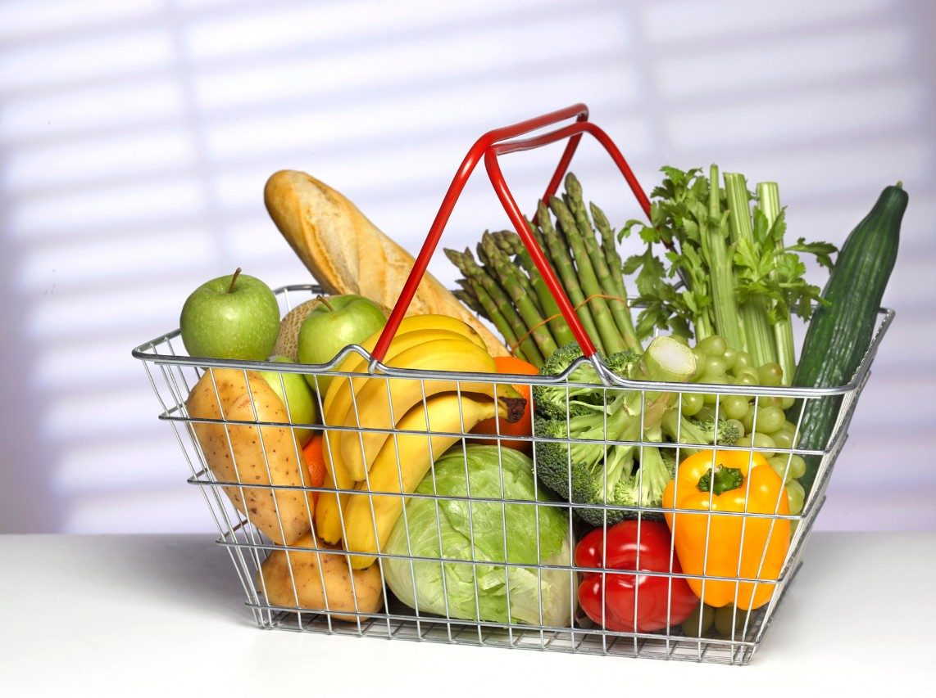
Our APP
Grocery Dash simplifies and makes your shopping experience more efficient by mapping out your grocery store trip in the most timely possible manner.

Slide 6
Functionality
02
How it works.

Slide 7

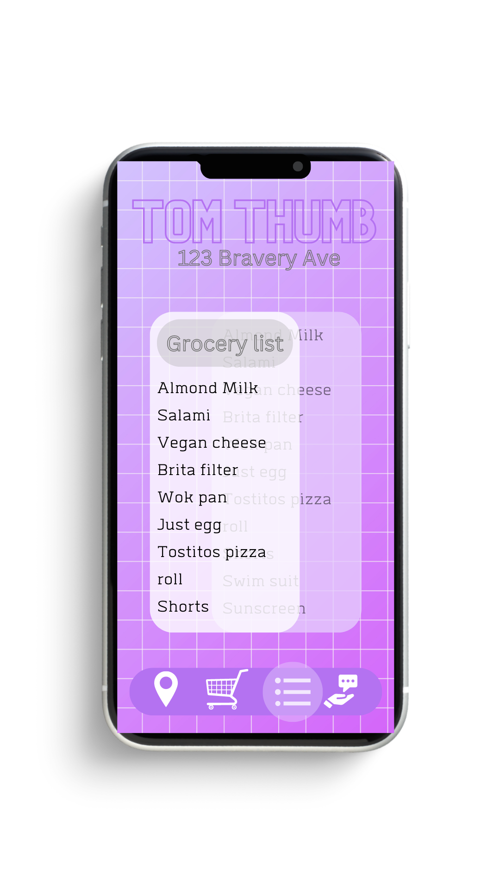
FIND YOUR STORE
2. Input grocery list
Be as detailed or as vague as you want! The app will find the closest match.

Slide 8
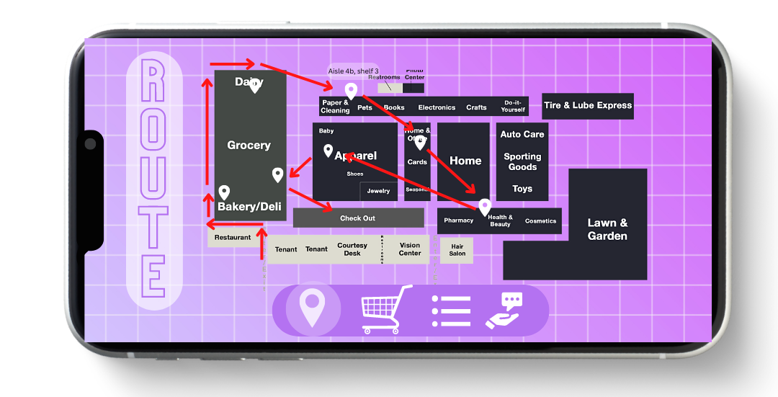

3. Watch the ideal route populate
The app references the official grocery store site/catalog to keep updated on any changes to layout. It finds the fastest most efficient way to grab all your groceries. This is also available in list form similar to a maps app.
Neptune
It’s the farthest planet from the Sun

Slide 9
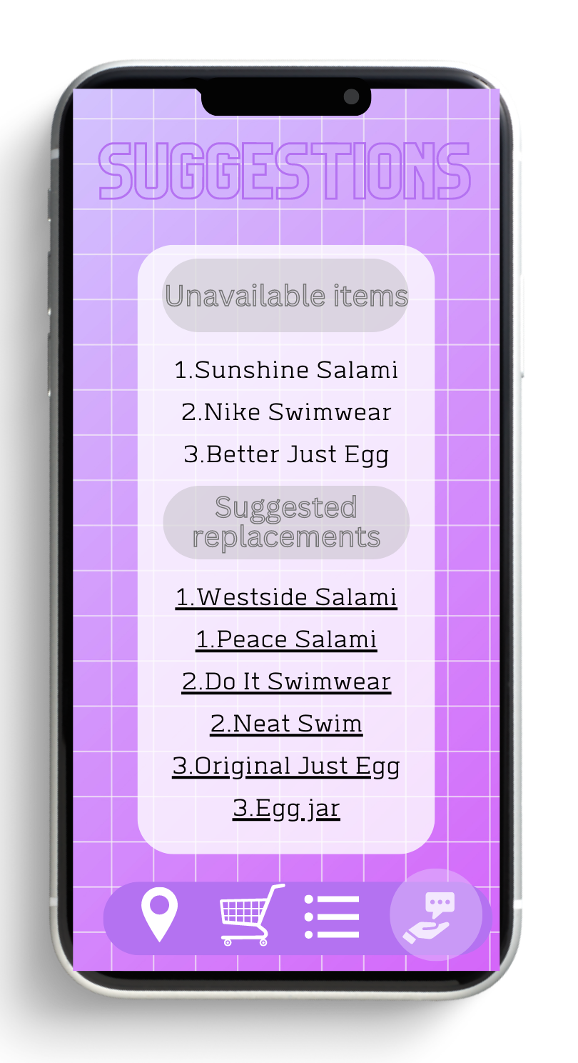
4. Don’t have your item?
Put an item in your list that is unavailable? The app will recommend the closet items and put them in your route instead. This could be from brand differences or even item differences.

Slide 10
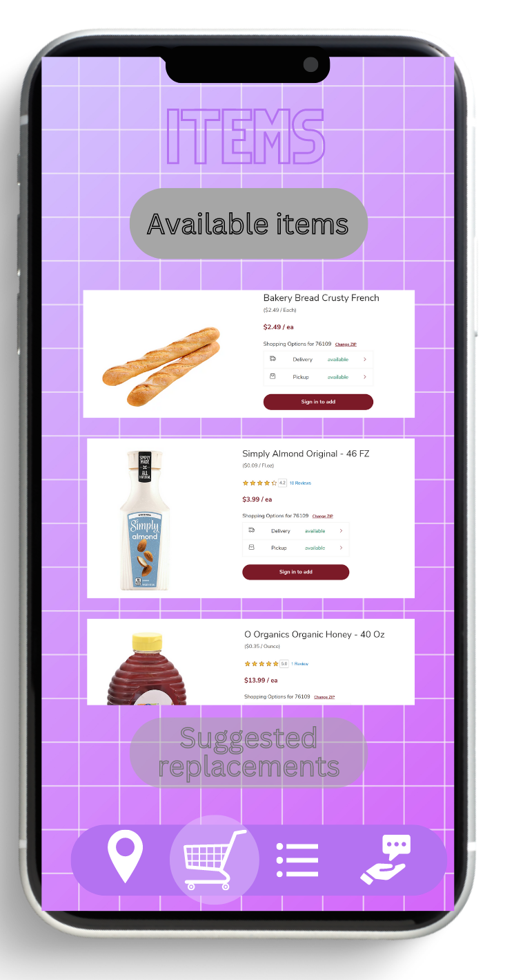
5. Want to browse?
Unsure of what you need but don’t want to wander? Curious about the difference between brands? The items tab connects to the store’s site and gives you more information you may not find in store.

Slide 11
Competitors
03
Why we’re better.

Slide 12
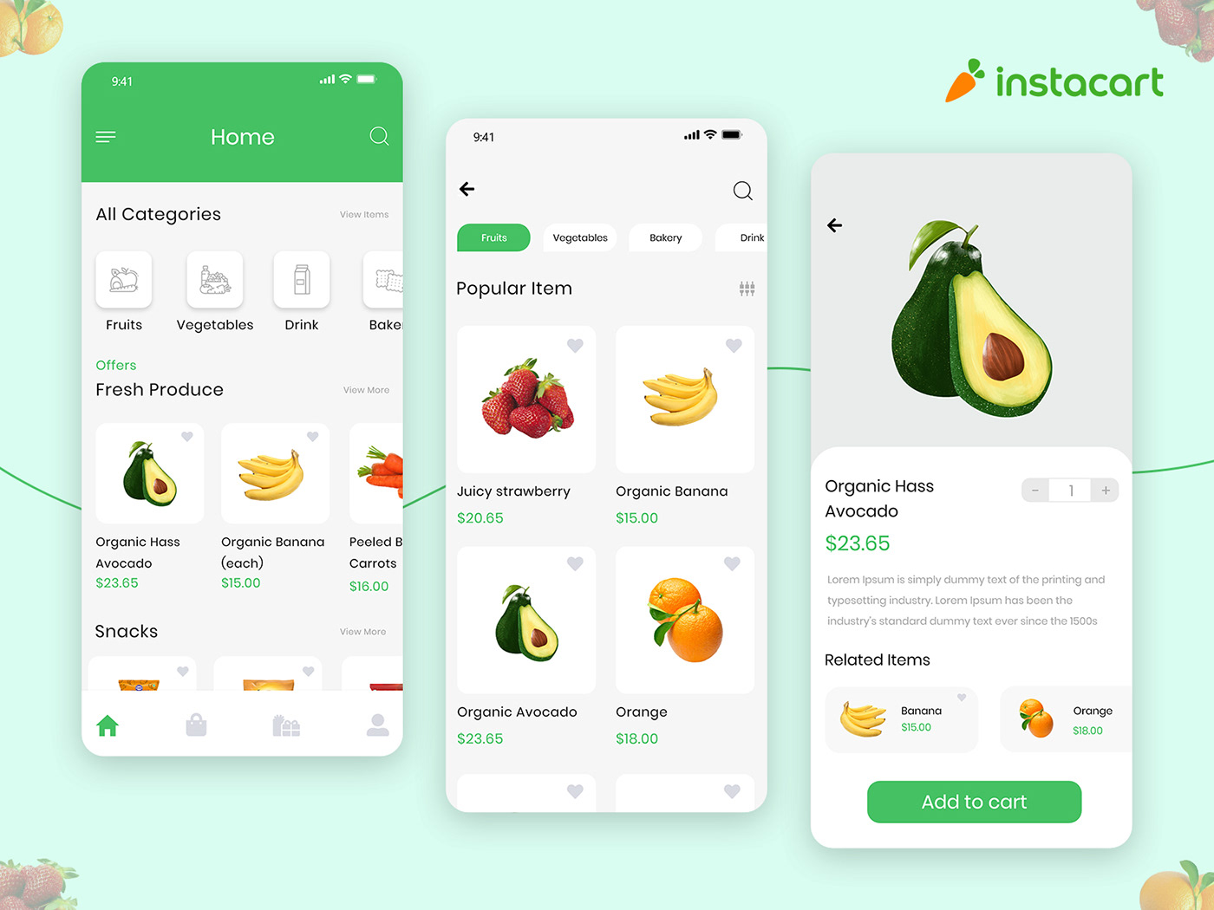
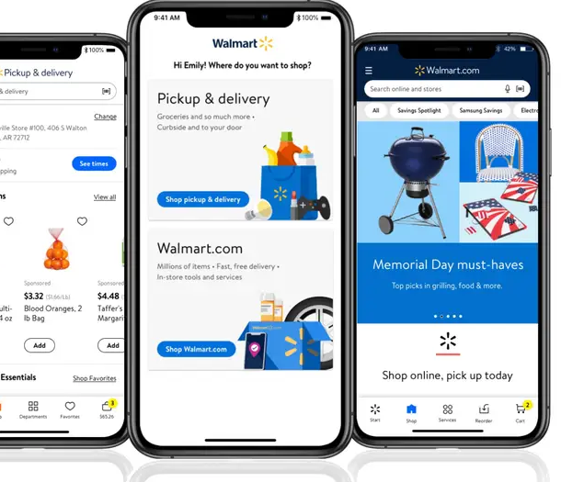
Instacart
2. grocery sites
(Or other shopping apps) Not cost effective. Relies on a stanger’s judgment rather than your own.
Overwhelming and confusing, does not provide a visual aide. We simplify the information giving you only what you need.

Slide 13
Team: GroceryDash
By: Kenoya Musa, Christopher Sheppard, Rami Ismael, Jakho Nematov

Slide 14
ON TO OUR DEMO:
Link: https://github.com/Rami-Ismael/grocery-dash

Slide 15
Thanks
Do you have any questions?
youremail@freepik.com
+91 620 421 838
yourcompany.com
Please keep this slide for attribution.

